Slide 1
WRAP
Volunteer Training
**Feel free to insert your church or ministry logo here

Slide 2
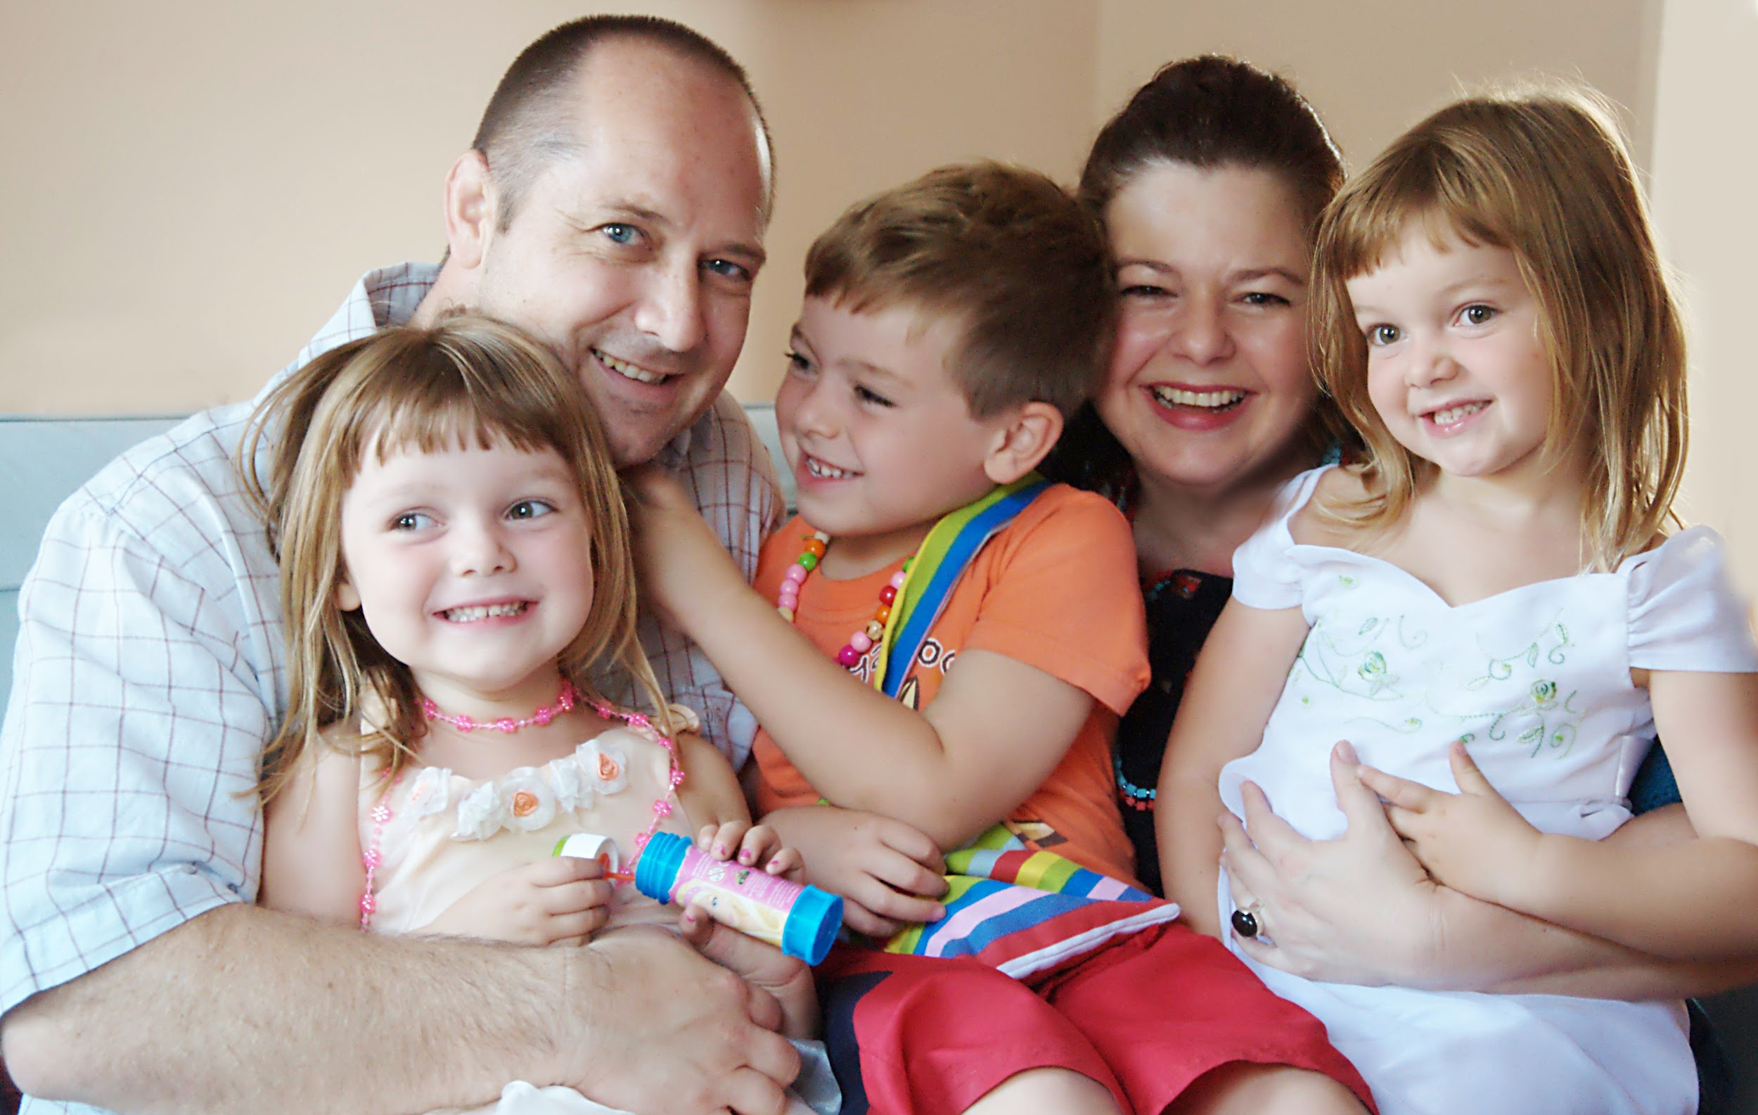
Presenter Information
Use this space to introduce yourself,
your role in Wrap Around
and a bit of your background/story.
***Don't forget to replace this photo with one of yourself or your family!***
Presenter Name

Slide 3
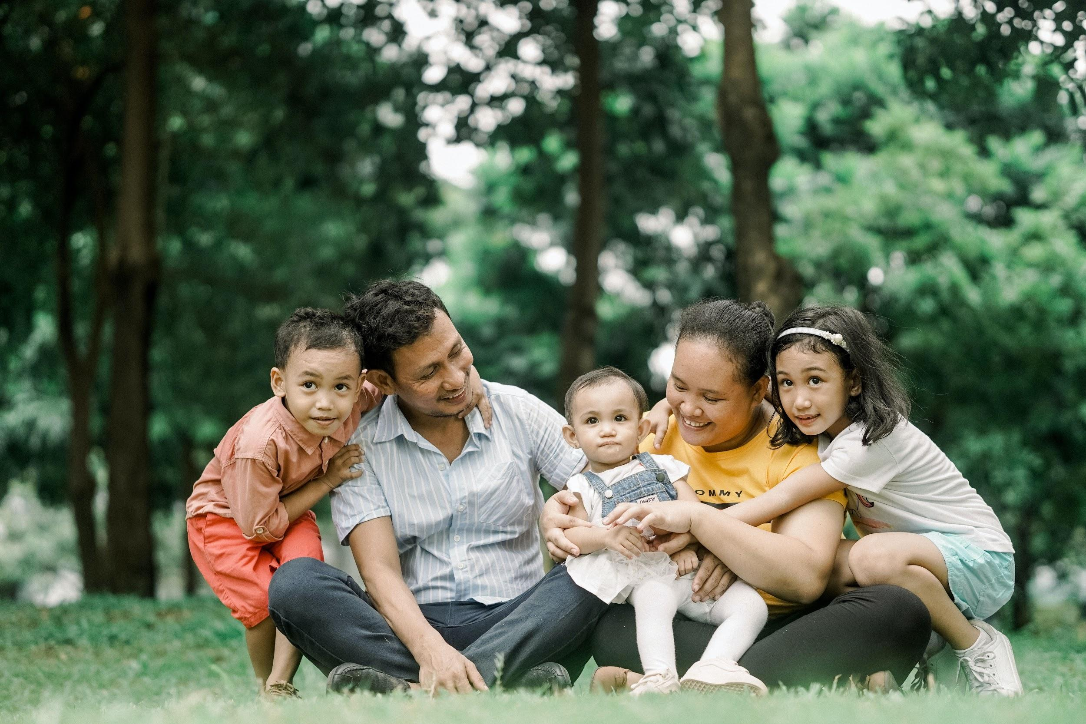
Family Information
Use this space to introduce the family you will be serving.
Have them give their family testimony during this time.
***Don't forget to replace this photo with one of the foster/adoptive/kinship family!***
Family Name

Slide 4
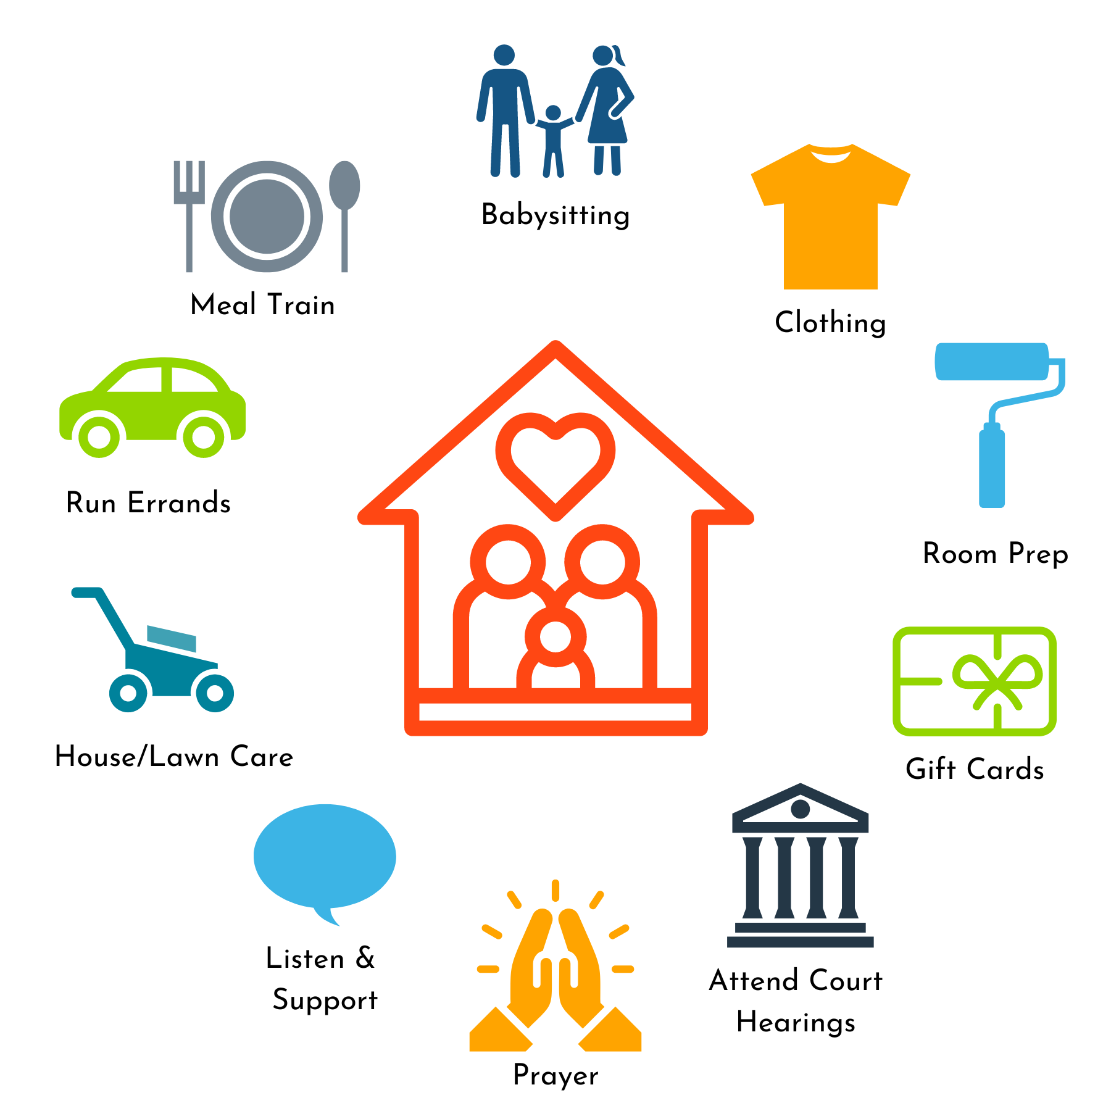
WRAP Ministry bridges the
needs of foster families
with the
resources of the faith community

Slide 5
Only
30-50%
Last More
Than A Year
8%
Make it to the
5 year mark
The primary reason foster families stop fostering is a lack of social support.
[Additionally, we have no way of knowing how many families would start fostering
if they knew they would have a team of people to support them in their journey.]
Notes:
It’s important to explain *WHY* Wrap Around ministry is so necessary.

Slide 6
“It is irresponsible to recruit new foster families without simultaneously recruiting support for those families.”
Kristin Allender
AKB State Director

Slide 7
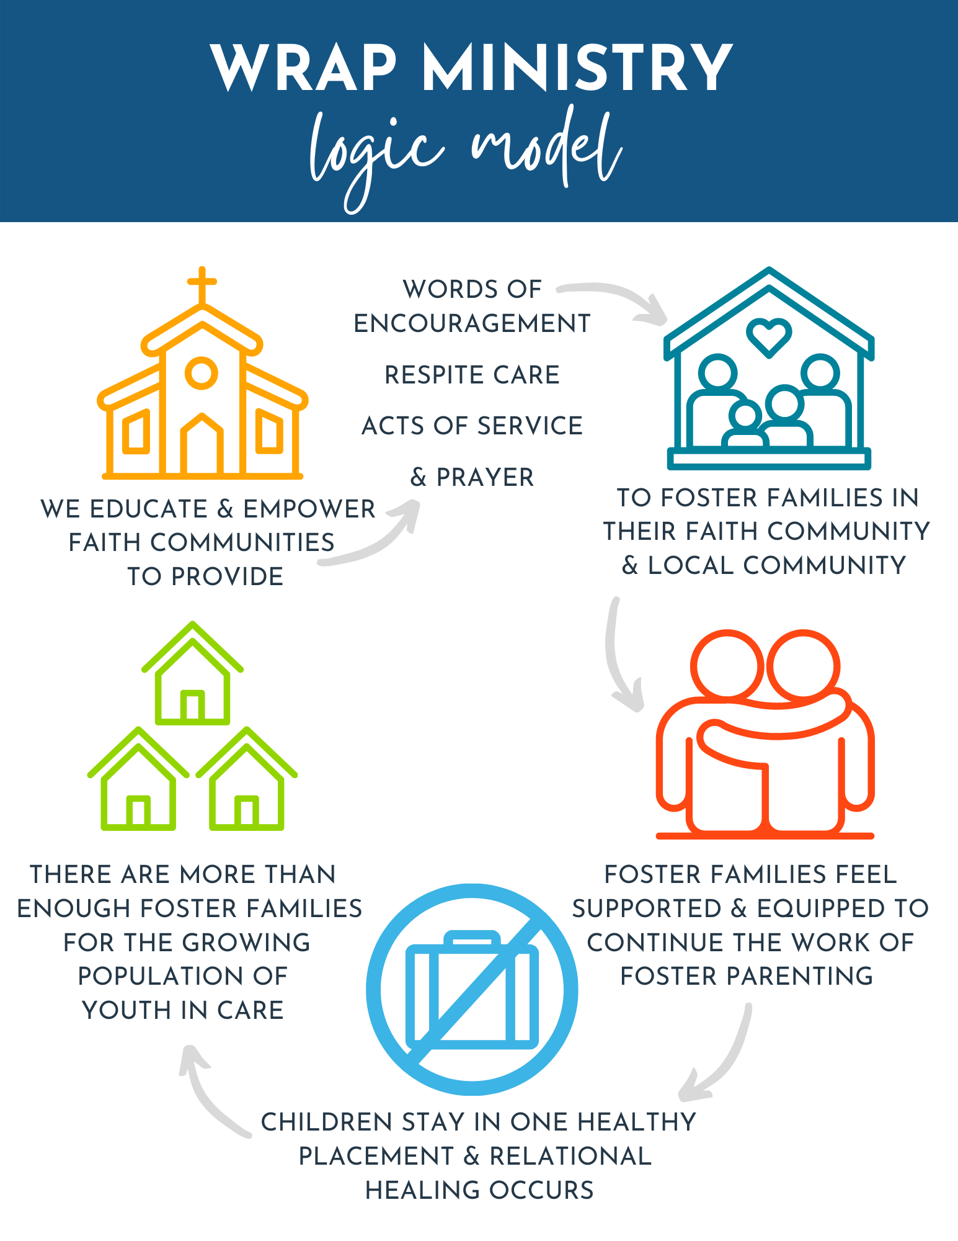
Notes:
WRAP Ministry is important because when foster families feel supported and equipped with what they need, children have the opportunity for stability, attachment and healing. The outcome is that there are enough foster homes available for children in need of a safe place to land.
***Change who waits.

Slide 8
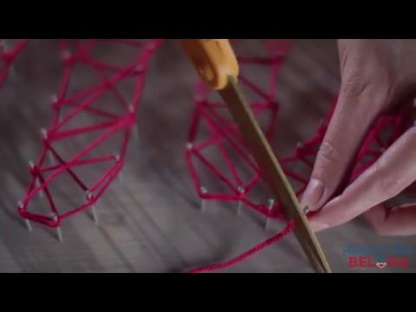
“Say YES to WRAP Around”

Slide 9
Whether you are 10 years old or 80,
a business person, stay at home parent, or student,
Wrap Ministry is for you!
There are countless ways to care.
Wrap around gives us all the opportunity to say Yes !

Slide 10
W- Words of Encouragement
R- Respite/Relief Care
A- Acts of Service
P- Prayer
There are four ways to serve on a WRAP Team

Slide 11
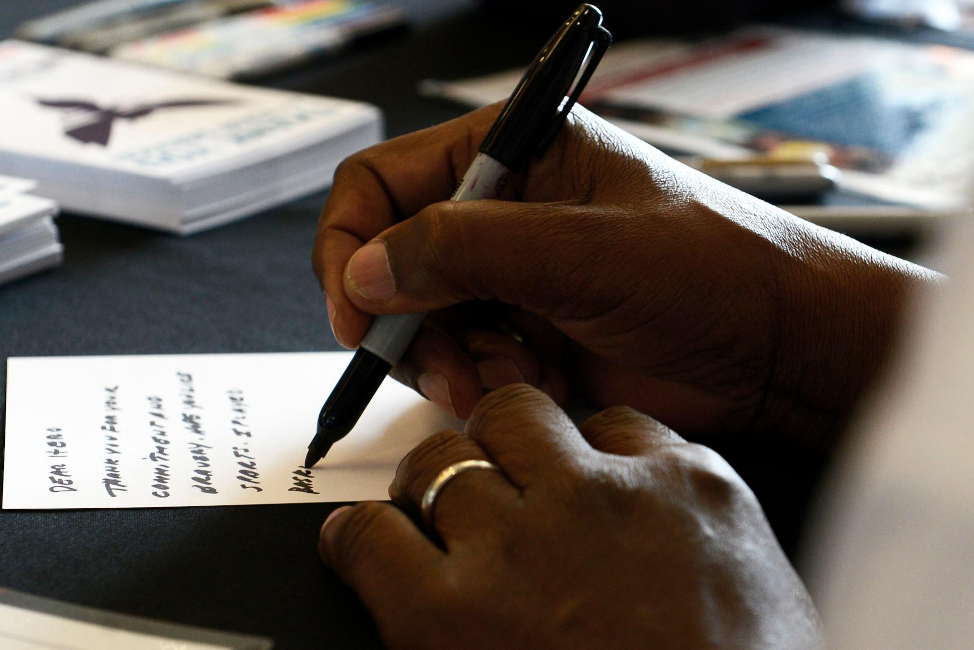
Words of Encouragement
Can use emails, texts, cards/mail, phone calls
Bolsters the family during the good and hard times
Boldly share the truth in love - these families crave your support and encouragement

Slide 12
Respite/Relief Care
Get to know the child(ren) alongside mom and/or dad
Be a natural & consistent presence in their lives
Talk to parents EACH time about whether or not your children (if applicable) can join you
Invest in these kids
If you are asked to provide respite and cannot, suggest another date. Be an ENTHUSIASTIC support!

Slide 13
Acts of Service
Offer enthusiastically and in a spirit of love
Designed to meet the needs of the family
Low maintenance for the family - we don't want to add stress or burdens on them
When serving, be mindful of the amount of time you stay to visit
Get creative and use your talents and skills

Slide 14
Prayer
It's a spiritual battle
Pray frequently & fervently
Tell the family you are praying for them
Be an ENTHUSIASTIC prayer warrior - your enthusiasm will show the family you WANT to pray for them
Pray for - child(ren), biological parents, foster/adoptive/kinship caregiver parents, judge, case worker, lawyers, therapists
Write out your prayers and send them to the family

Slide 15
"If there's anything
I can do, let me know!"
-a well intentioned friend
INSTEAD OF THIS...

Slide 16
Try This Instead…
Meals
Gift Cards
We would like to bring you
a meal, what night is best
for you?
Drop off a gift card for groceries, gas, a restaurant or clothing store.
Tag on Errands
Personal (but brief) Visit
I'm running by the store today, what can I pick up for you and when can I drop it off?
We would like to stop by for a few minutes to say "hello", is that okay? When would be a good time?

Slide 17
Confidentiality
Appropriate Touch
This is the child's story
Foster families sign confidentiality agreements
Operate on a "need to know" basis
Be cautious about what questions you ask, especially around children.
Mandated Reporting
Always defer to the family on this topic
In general - side hugs, high fives, fist bumps are appropriate touch
Never be alone with any child - always have another person present

Slide 18
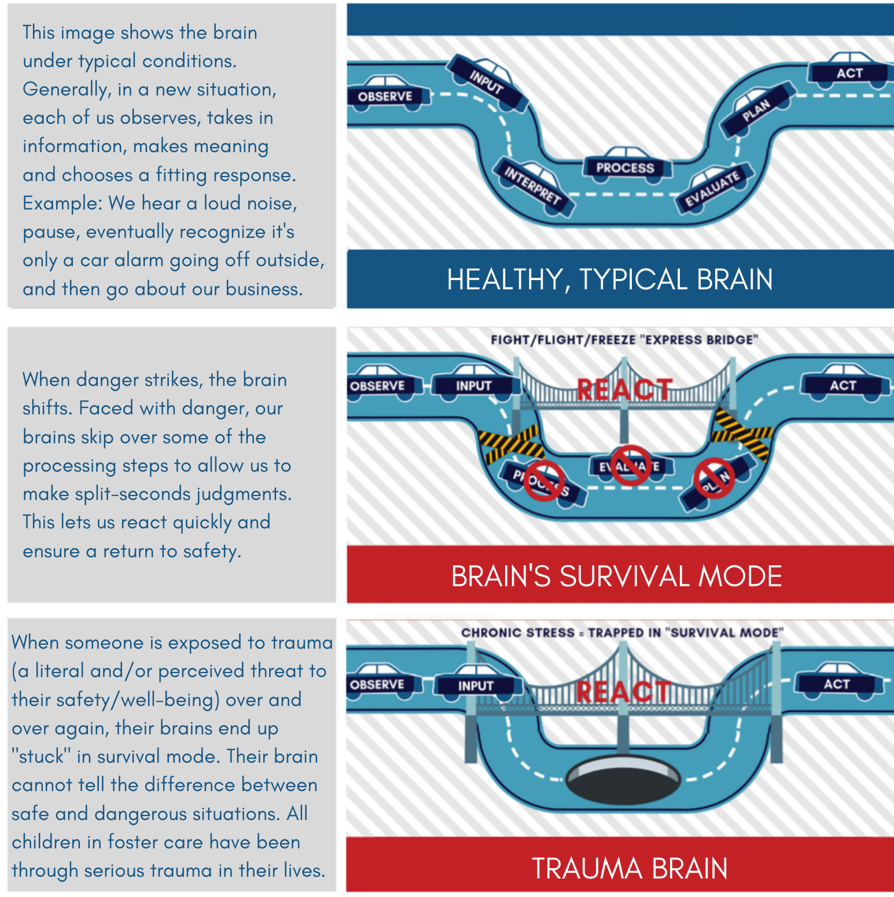
How Trauma
Affects the
Brain
Notes:
OR play https://youtu.be/lPftosmseYE

Slide 19
Visit www.BelongUniversity.com for additional
trauma training resources, including a FREE one hour “Becoming Trauma Aware” course

Slide 20
Family Picture and Information
Team Roster & Contact Info
Wrap Volunteer Handbook
Background Check Application
Kids Safety Training Info (as needed)
TEAM RESOURCES
Notes:
This is a list of handouts/resources you can provide to your volunteers/wrap team.

Slide 21
How to be a Friend to a Foster Parent
Recognize they aren't heroes - they are parents just like everyone else
Give them room to talk, but don't ask for details
Don't tell them to quit
Traditional parenting techniques may not work
Ask about respite needs
Love their kids well

Slide 22
Frequently Asked Questions
What do I do when I can no longer serve on this team?
How are families chosen?
How long does a WRAP Team wrap around a family?
Other questions?
Notes:
Share how you will be choosing the family to be served.
How do you want volunteers to update if they can no longer serve on the team?
Reiterate the timeframe you are asking/requiring of volunteers/WRAP team to serve.
Address any additional questions.

Slide 23
People of faith are the largest, most organized, mobilized and called body of volunteers in the world!
So what part of WRAP will you say Yes to!

Slide 24
Thank you
Notes:
This concludes the training; however, if you wish for your volunteers to complete the 1 hour Trauma Training - you can provide the link to complete and/or add it as a part of this training.

