Slide 1
WRAP
Volunteer Training
**Feel free to insert your church or ministry logo here
Notes:
Welcome everyone and explain how everyone is here to learn how to wrap around foster families with kind and intentional support.

Slide 2
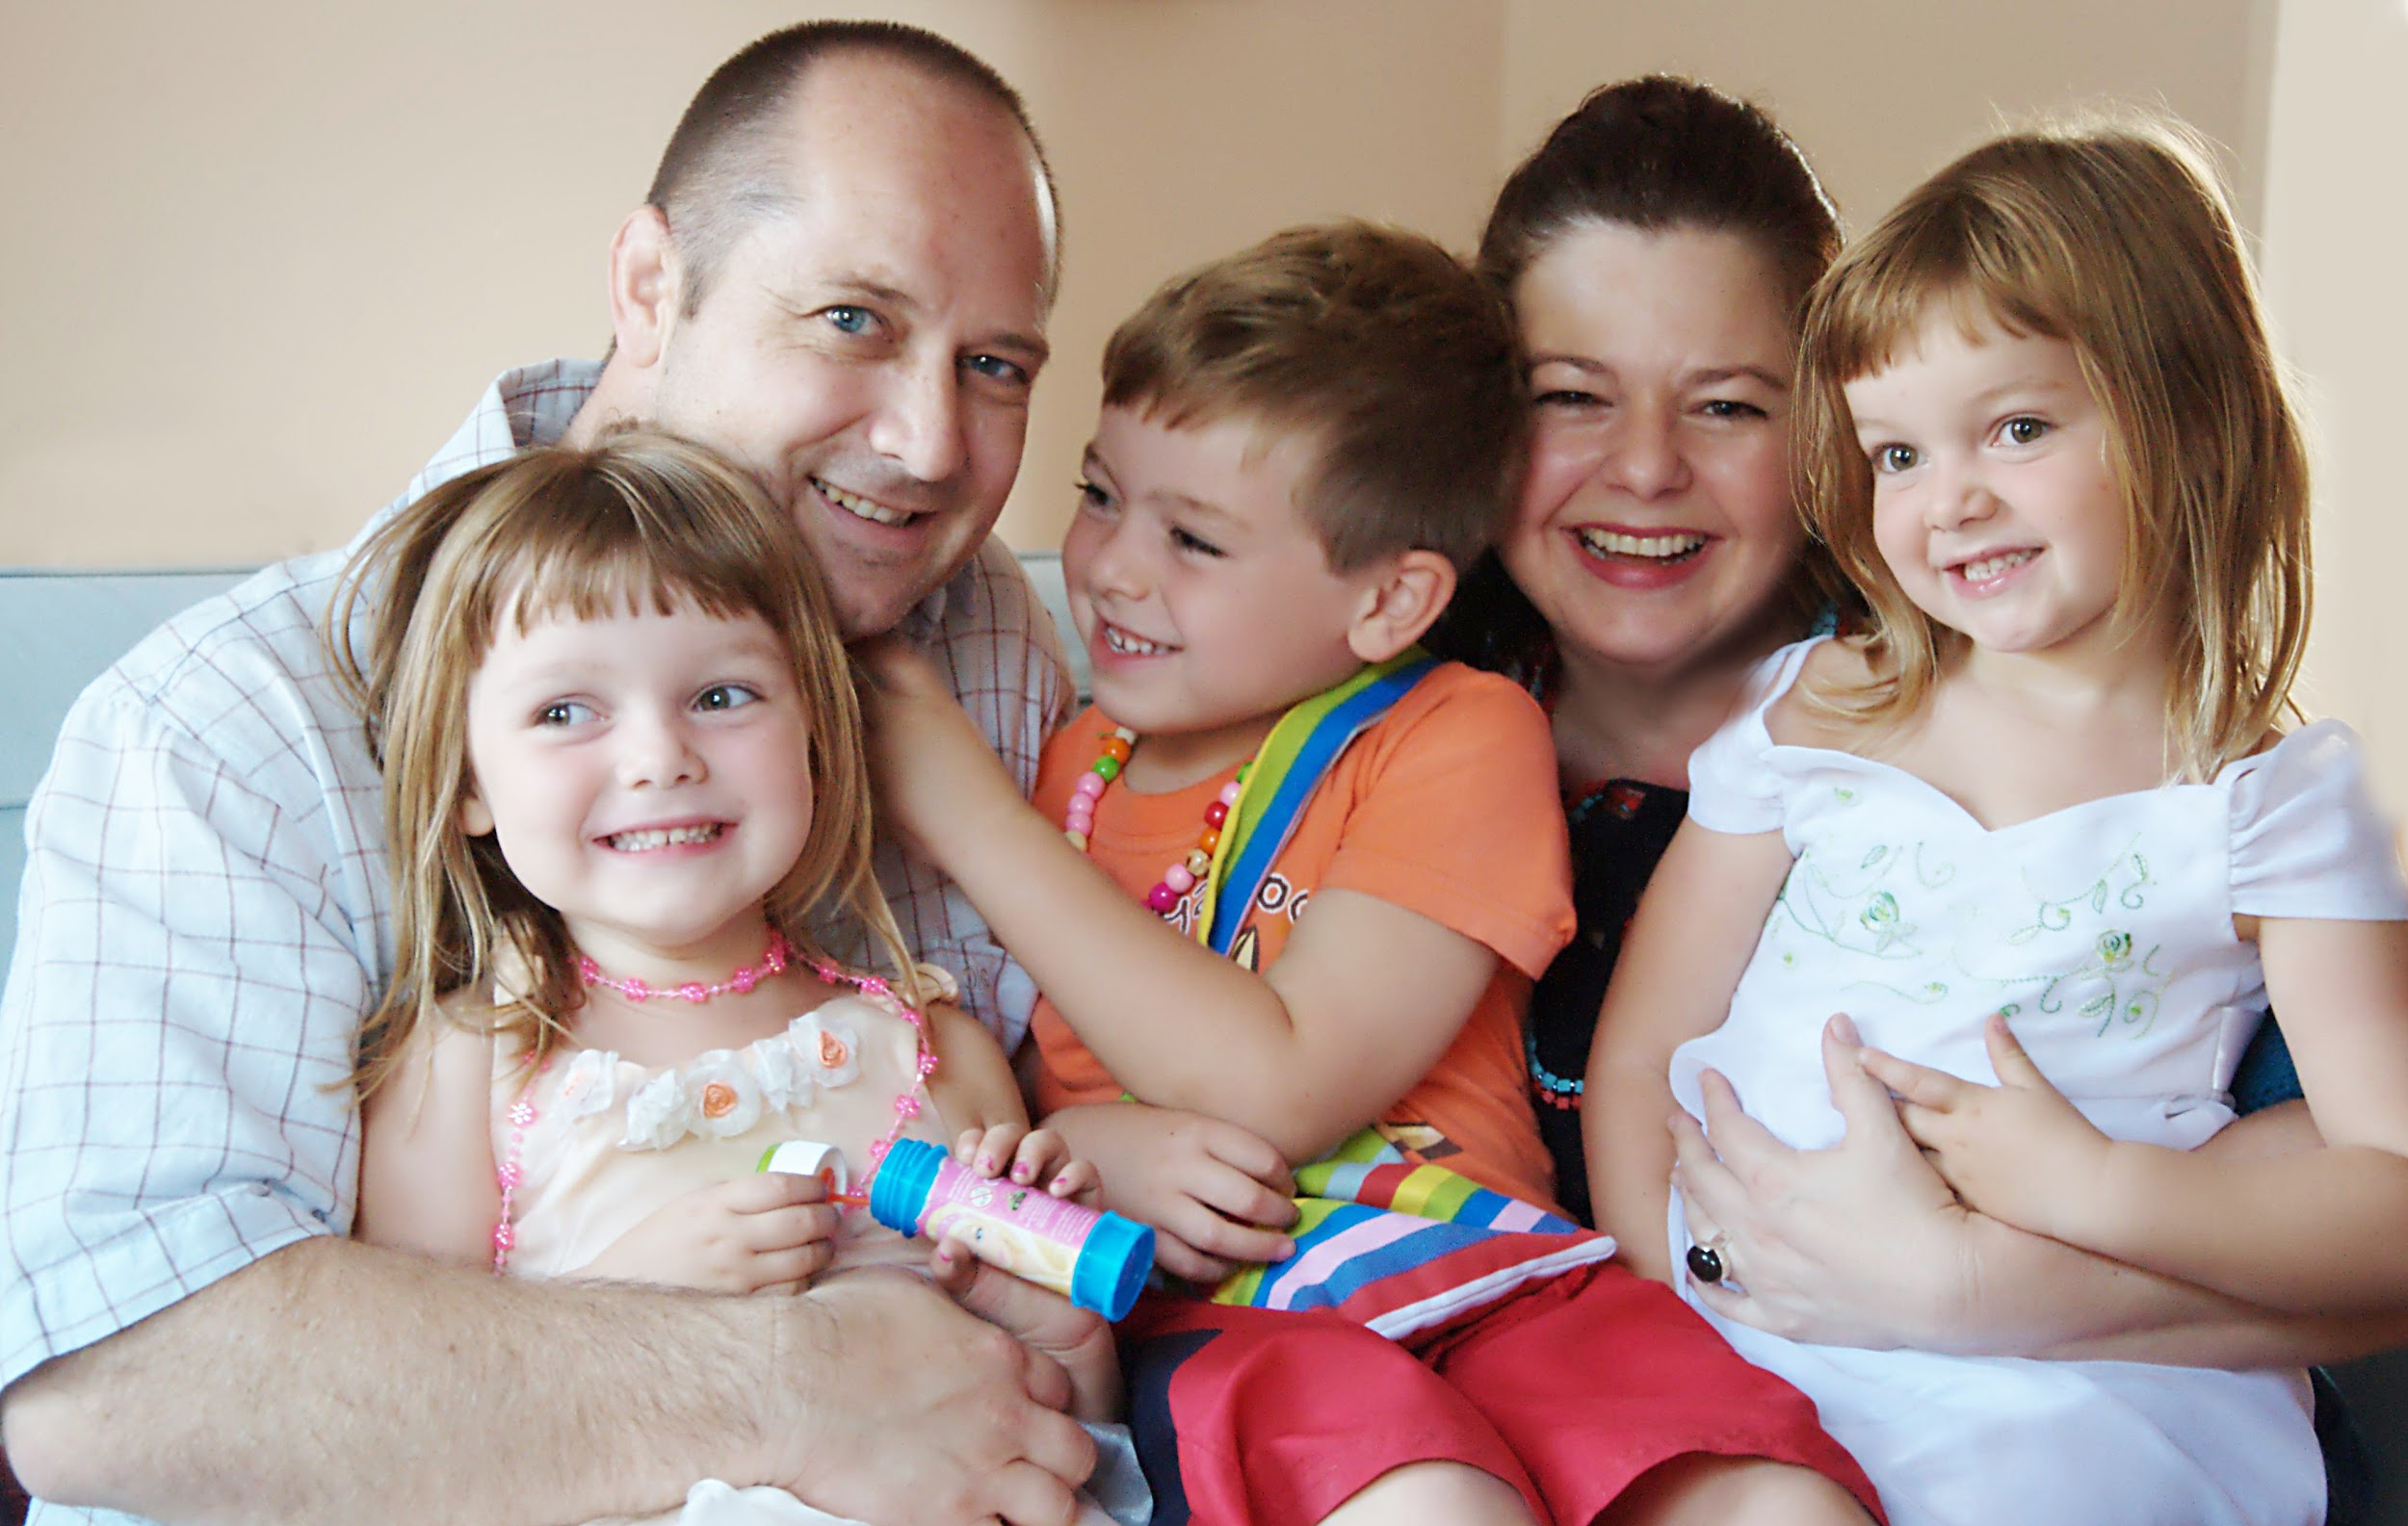
Presenter Information
Presenter Name
Use this space to introduce yourself,
your role in Wrap Around
and a bit of your background/story.
***Don't forget to replace this photo with one of yourself or your family!***
Notes:
Explain why you care about foster care and how you got to this point to be leading the training.
Create an excitement to be serving foster care in your community.

Slide 3
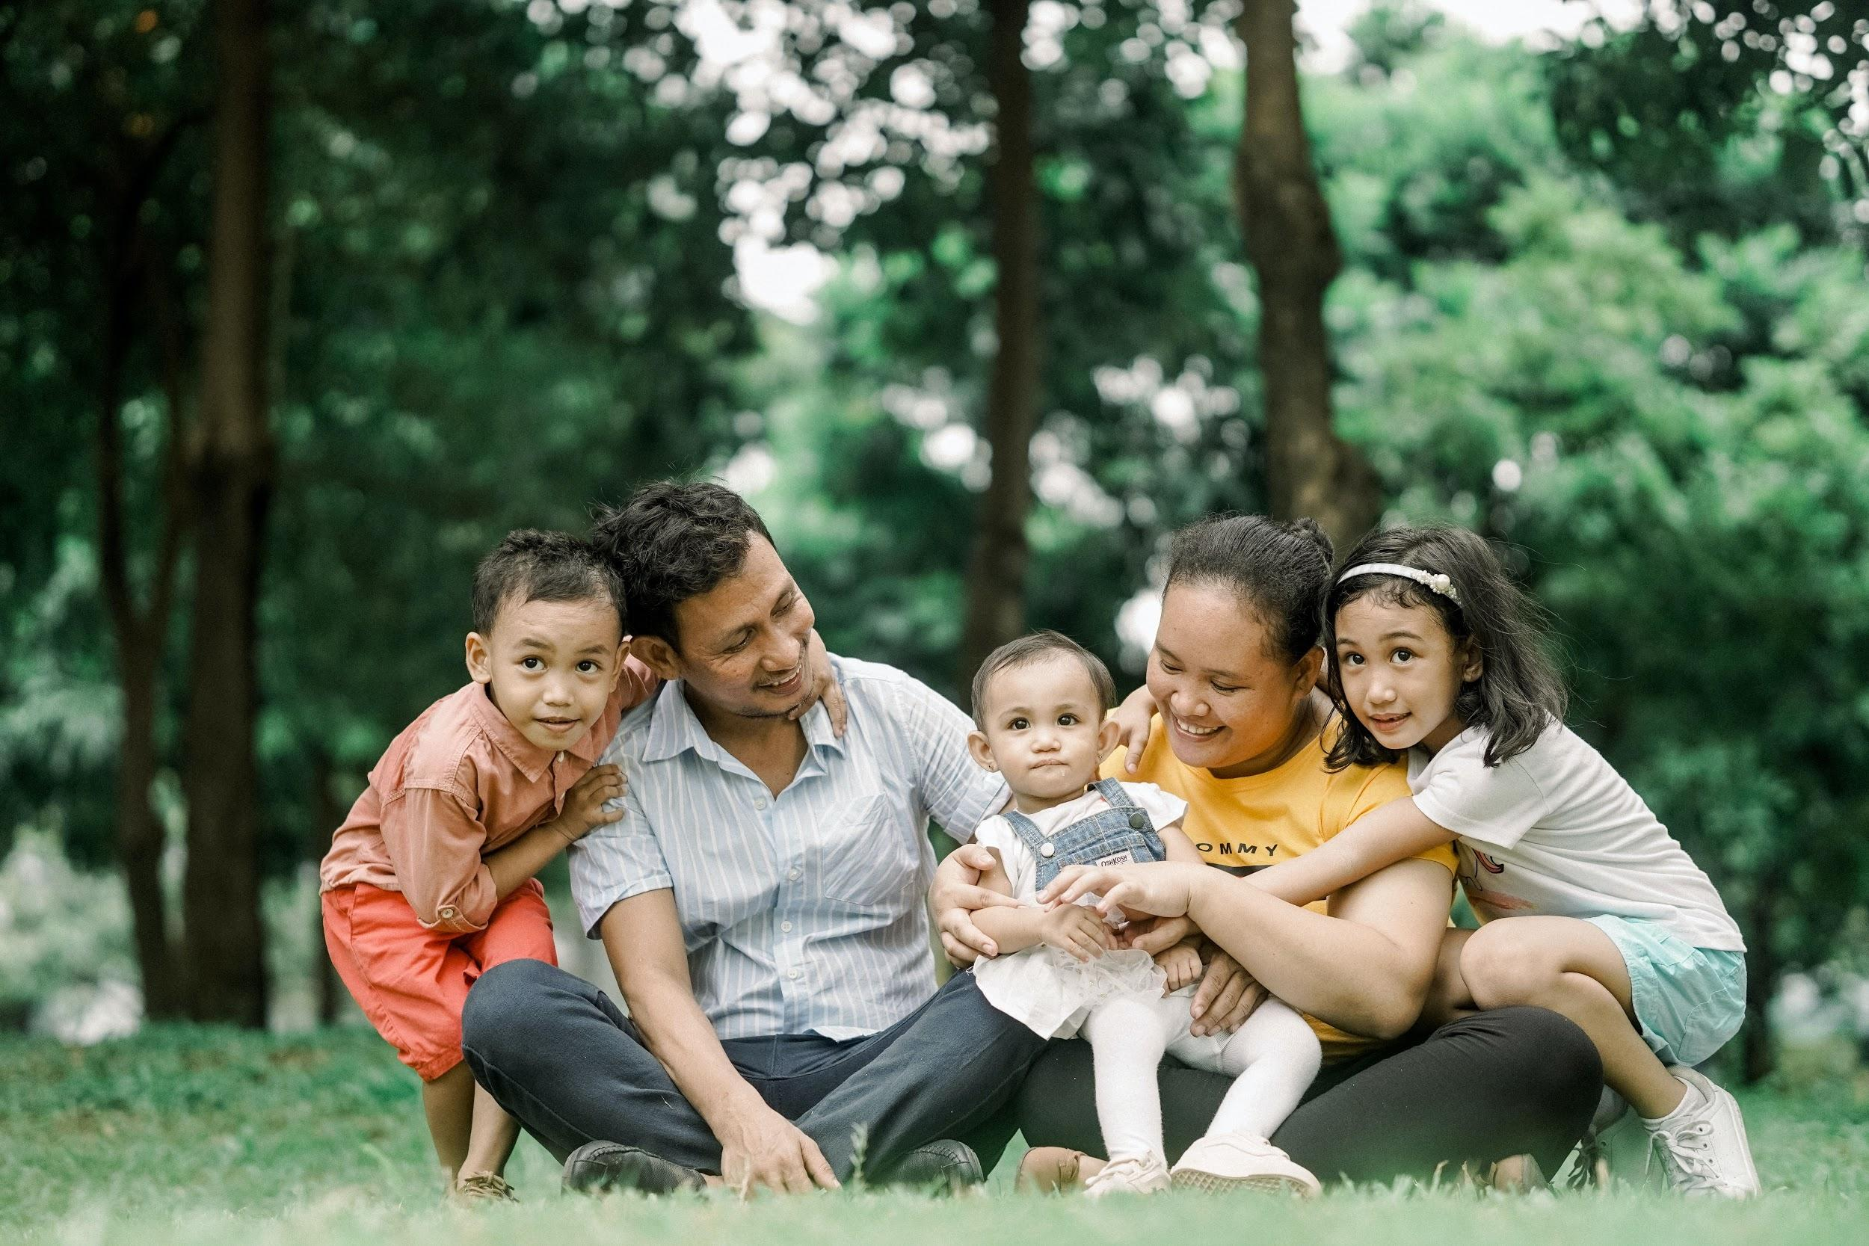
Family Information
Family Name
Use this space to introduce the family you will be serving.
Have them give their family testimony during this time.
***Don't forget to replace this photo with one of the foster/adoptive/kinship family!***
Notes:
If you have a foster family, then you can have their picture on the third slide with a brief introduction.

Slide 4
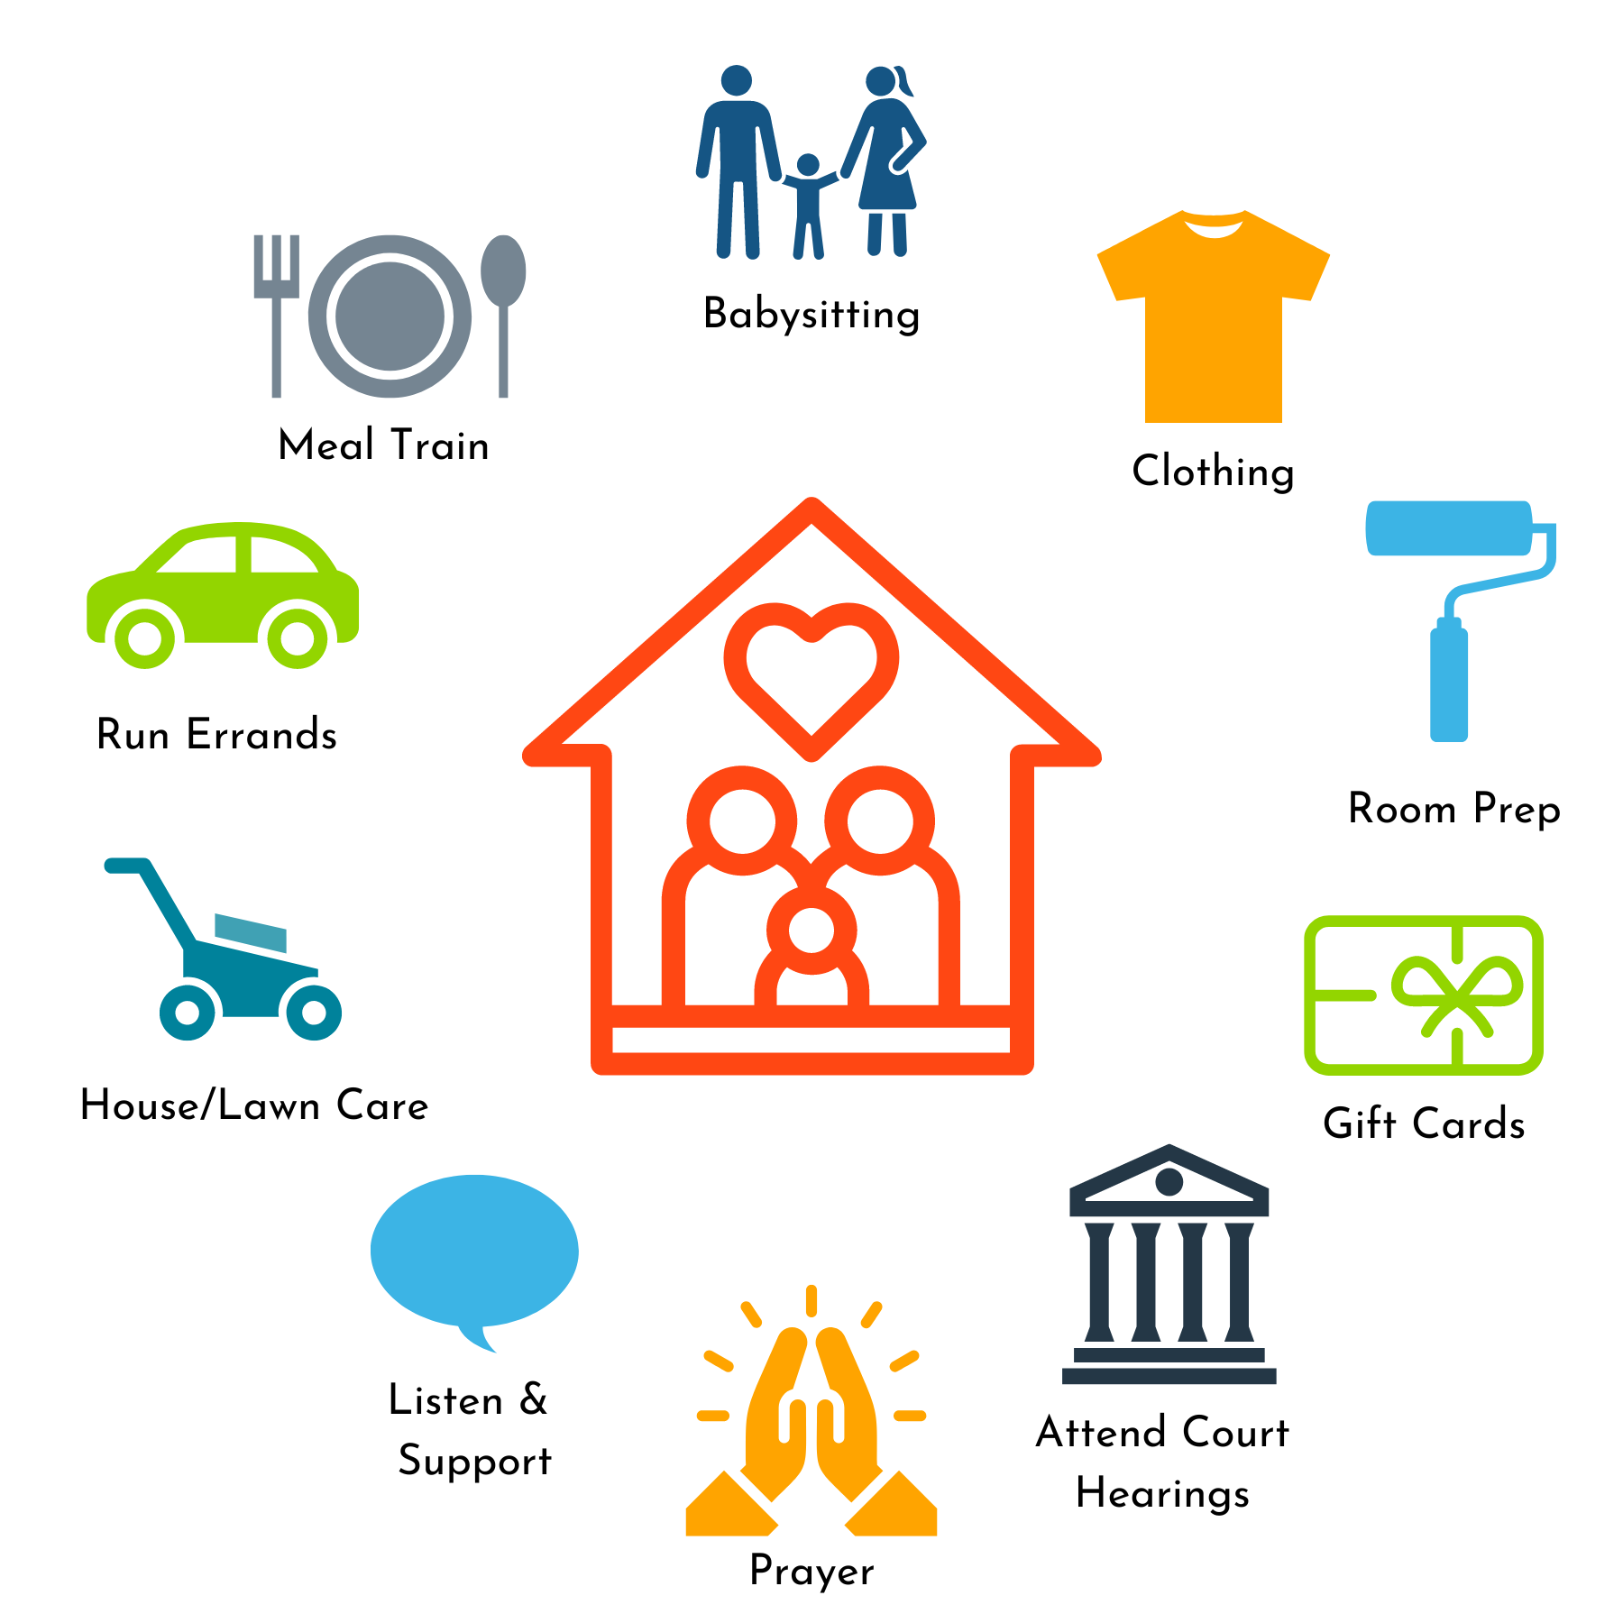
WRAP Ministry bridges the
needs of foster families
with the
resources of the faith community
Notes:
Explain what that looks like with the examples shown…examples: Taking a meal, getting new clothes for a placement, mowing a yard

Slide 5
30-50%
Last More
Than A Year
Only
8%
Make it to the
5 year mark
The primary reason foster families stop fostering is a lack of social support.
[Additionally, we have no way of knowing how many families would start fostering
if they knew they would have a team of people to support them in their journey.]
Notes:
It’s important to explain *WHY* Wrap Around ministry is so necessary.
Families feel isolated and alone as they carry a lot of heavy things. They can lose communities as they step into this work and they need more specific help without having to ask for it.

Slide 6
“It is irresponsible to recruit new foster families without simultaneously recruiting support for those families.”
Kristin Allender
TKB Executive Director
Notes:
As foster parents are burning out and kids are coming into care at rapid rates, we are trying to help the pain point for the foster parents. Foster Parents are the first responders and we can all say yes to something in serving their needs.

Slide 7
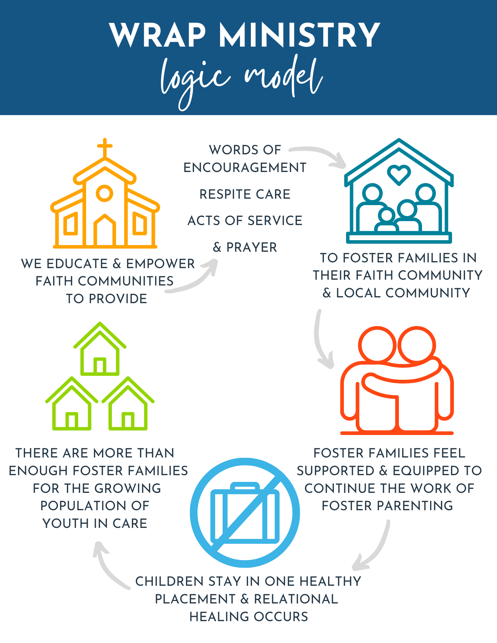
Notes:
WRAP Ministry is important because when foster families feel supported and equipped with what they need, children have the opportunity for stability, attachment and healing. The outcome is that there are enough foster homes available for children in need of a safe place to land.
We want less disruptions for the children and the families. They have enough stamina with the wrap support to keep going and it shows the children in foster care that people care.
***Change who waits.

Slide 8
Notes:
https://vimeo.com/250043801
This gives you a good visual of the purpose and importance of WRAP around care.

Slide 9
Whether you are 10 years old or 80,
a business person, stay at home parent, or student,
Wrap Ministry is for you!
There are countless ways to care.
Wrap around gives us all the opportunity to say Yes !
Notes:
This gives you a good visual of the purpose and importance of WRAP around care. We have kids that can make care packages and bake goodies. We have homebound people in the church who write encouraging notes.

Slide 10
W- Words of Encouragement
R- Respite/Relief Care
A- Acts of Service
P- Prayer
There are four ways to serve on a WRAP Team
Notes:
These are the four lanes of service and everyone will choose a lane to serve in. Sometimes Prayer can overlap.
Respite is babysitting and anyone can help for up to 48 hours that’s approved by the family.

Slide 11
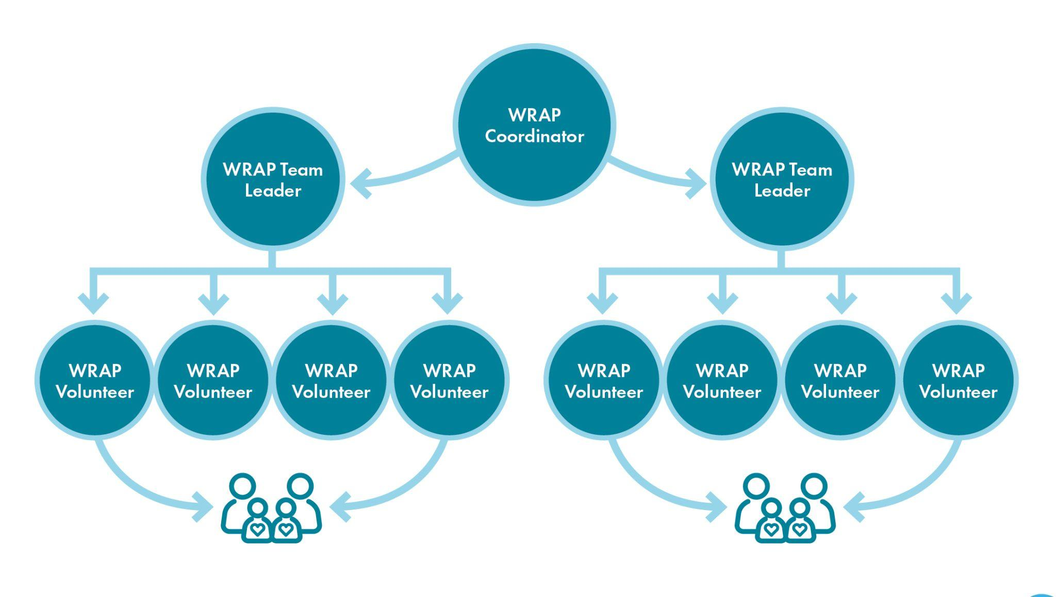

Slide 12
Words of Encouragement
Can use emails, texts, cards/mail, phone calls
Bolsters the family during the good and hard times
Boldly share the truth in love - these families crave your support and encouragement
Notes:
We’ve all needed an encouraging text or card in the mail on hard days. You’d be surprised at how simple and thoughtful these touchpoints have helped foster families in the trenches.
Some of the kids even appreciate cards on their birthdays and special occasions.

Slide 13
Respite/Relief Care
Get to know the child(ren) alongside mom and/or dad
Be a natural & consistent presence in their lives
Talk to parents EACH time about whether or not your children (if applicable) can join you
Invest in these kids
If you are asked to provide respite and cannot, suggest another date. Be an ENTHUSIASTIC support!
Notes:
Give them specific options to choose from so they don’t feel any pressure to pick a time.
Sometimes foster parents haven’t been out on a date since they started fostering.
As you give the parents a break, it directly helps their capacity to keep going and to feel less alone.

Slide 14
Acts of Service
Offer enthusiastically and in a spirit of love
Designed to meet the needs of the family
Low maintenance for the family - we don't want to add stress or burdens on them
When serving, be mindful of the amount of time you stay to visit
Get creative and use your talents and skills
Notes:
This is about what their needs are and the survey we give them will help us see their needs. Sometimes people want help with laundry and sometimes they don’t. We don’t want to add more stress but only want to lighten their load.
Think of things you’re good at that might be helpful. Baking? Mowing yards? One WRAP team participant only brought fresh muffins each month to the family and it was perfect and an amazing blessing. One showed up to mow their grass throughout the month and it gave the parents space to deal with the hard behaviors happening inside the house.

Slide 15
Prayer
It's a spiritual battle
Pray frequently & fervently
Tell the family you are praying for them
Be an ENTHUSIASTIC prayer warrior - your enthusiasm will show the family you WANT to pray for them
Pray for - child(ren), biological parents, foster/adoptive/kinship caregiver parents, judge, case worker, lawyers, therapists
Write out your prayers and send them to the family
Notes:
Our battle is not against flesh and blood but against evil in the spiritual realms. Prayer is vital.
Sometimes the WRAP team will be the only people praying for these children in their lifetime. We don’t know the impact of our prayers and it matters!

Slide 16
"If there's anything I can do, let me know!"
-a well intentioned friend
INSTEAD OF THIS...
Notes:
But we can’t think about how to help others when we’re drowning.
WRAP Teams don’t need to say that to any foster parents ever. Please give specifics.
Would Thursday or Friday work better for you for a meal? Would Friday or Saturday night work for babysitting?

Slide 17
Try This Instead…
Meals
Gift Cards
We would like to bring you
a meal, what night is best
for you?
Drop off a gift card for groceries, gas, a restaurant or clothing store.
Tag on Errands
Personal (but brief) Visit
I'm running by the store today, what can I pick up for you and when can I drop it off?
We would like to stop by for a few minutes to say "hello", is that okay? When would be a good time?
Notes:
Be mindful when you drop off items, meals etc. that they may not want to talk or have time to chat for 30 mins. Brief and kind deliveries are usually best.

Slide 18
Confidentiality
Appropriate Touch
This is the child's story
Foster families sign confidentiality agreements
Operate on a "need to know" basis
Be cautious about what questions you ask, especially around children.
Mandated Reporting
Always defer to the family on this topic
In general - side hugs, high fives, fist bumps are appropriate touch
Never be alone with any child - always have another person present
Notes:
In the event, a business or faith community needs the mandated reporter training we mention in WRAP, you can give them this: https://www.tn.gov/dcs/program-areas/child-safety/reporting/faqs.html
Even if we’re curious about a child’s story, we don’t need to ask questions about it.
One foster family had church members walk up and ask things like, “Is he a drug baby?” and “Is their mom an addict?” It’s not appropriate and the main goal of WRAP is to give intentional support and care for the family without needing to know details about the kids.
If you’re doing respite, try to give that support with two people from the team so you aren’t alone with a child.

Slide 19
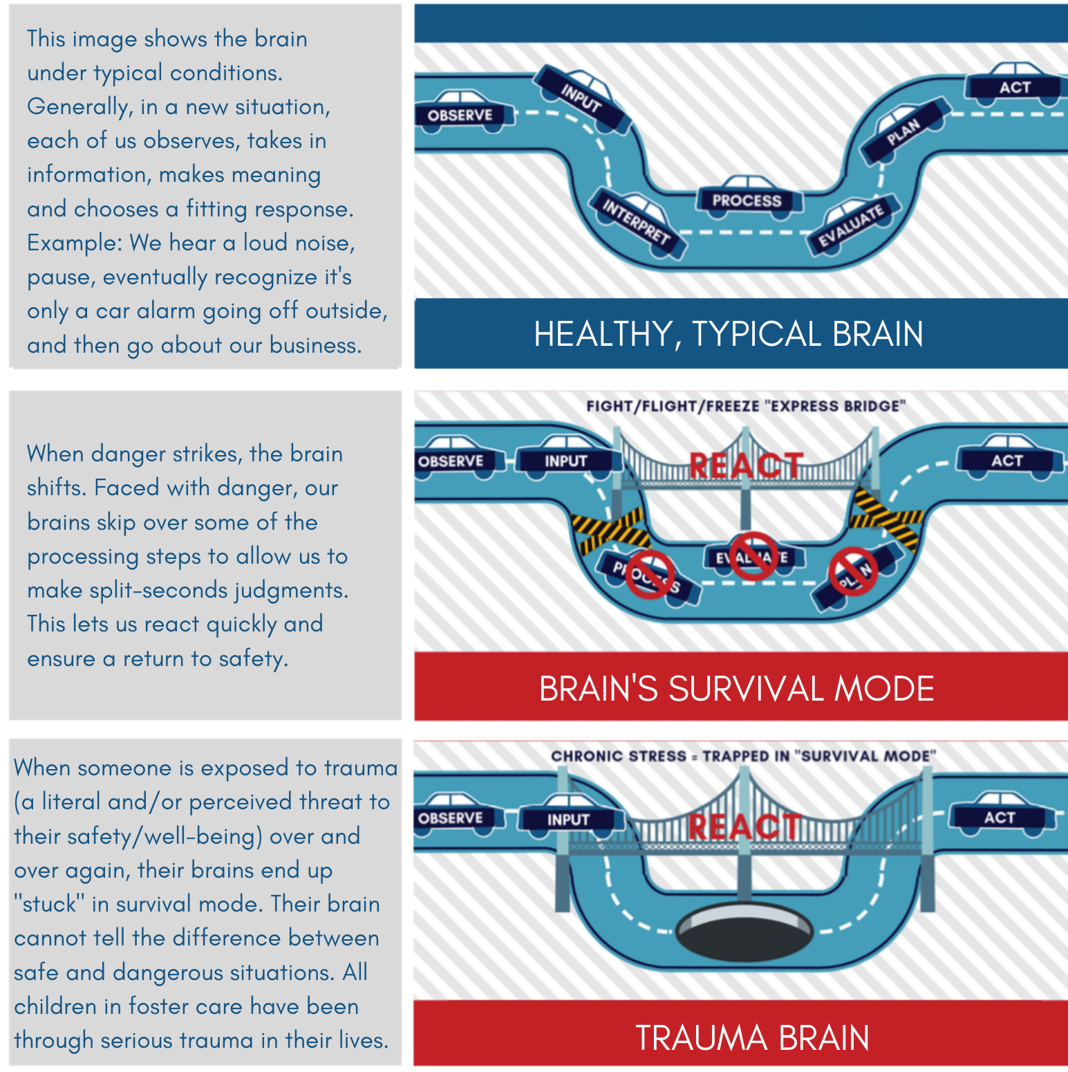
How Trauma
Affects the
Brain
Notes:
OR play https://youtu.be/lPftosmseYE
You can also play this video: https://youtu.be/lPftosmseYE
Please don’t judge the trauma responses of the children in foster care. Love with grace and kindness.

Slide 20
Visit www.BelongUniversity.com for additional
trauma training resources, including a FREE one hour “Becoming Trauma Aware” course

Slide 21
Family Picture and Information
Team Roster & Contact Info
Wrap Volunteer Handbook
Background Check Application
Kids Safety Training Info (as needed)
TEAM RESOURCES
Notes:
This is a list of handouts/resources you can provide to your volunteers/wrap team.

Slide 22
How to be a Friend to a Foster Parent
Recognize they aren't heroes - they are parents just like everyone else
Give them room to talk, but don't ask for details
Don't tell them to quit
Traditional parenting techniques may not work
Ask about respite needs
Love their kids well
Notes:
Foster Parents don’t want to be called saints. They’re regular people and don’t want to be put on a pedestal.
They need you to help them feel seen and encouraged, not to tell them to give up.

Slide 23
Frequently Asked Questions
How are families chosen?
What do I do when I can no longer serve on this team?
How long does a WRAP Team wrap around a family?
Other questions?
Notes:
Share how you will be choosing the family to be served.
How do you want volunteers to update if they can no longer serve on the team?
Reiterate the timeframe you are asking/requiring of volunteers/WRAP team to serve.
Address any additional questions.

Slide 24
People of faith are the largest, most organized, mobilized and called body of volunteers in the world!
So what part of WRAP will you say Yes to!

Slide 25
Thank you!.
Thank you
Notes:
This concludes the training; however, if you wish for your volunteers to complete the 1 hour Trauma Training - you can provide the link to complete and/or add it as a part of this training.

